Slide 1
Intermolecular forces
Week 8 Term2

Slide 2
Molecular shape
Shapes of simple molecules include linear, triangular planar, tetrahedral, pyramidal and bent.

Slide 3
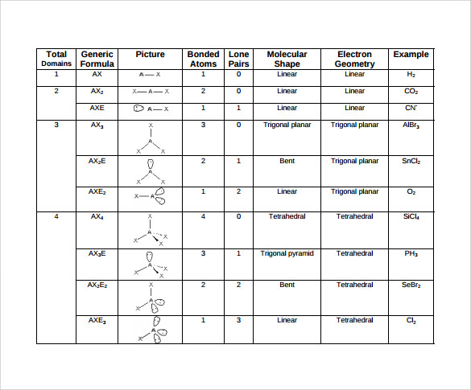

Slide 4
Molecular shape, according to valence shell electron pair repulsion theory (VSEPR), results from repulsion between groups of electrons, both bonding and non-bonding, in the valence shell of the central atom in a molecule.
A molecule’s shape depends upon the number of groups of valence electrons on its central atom.

Slide 5
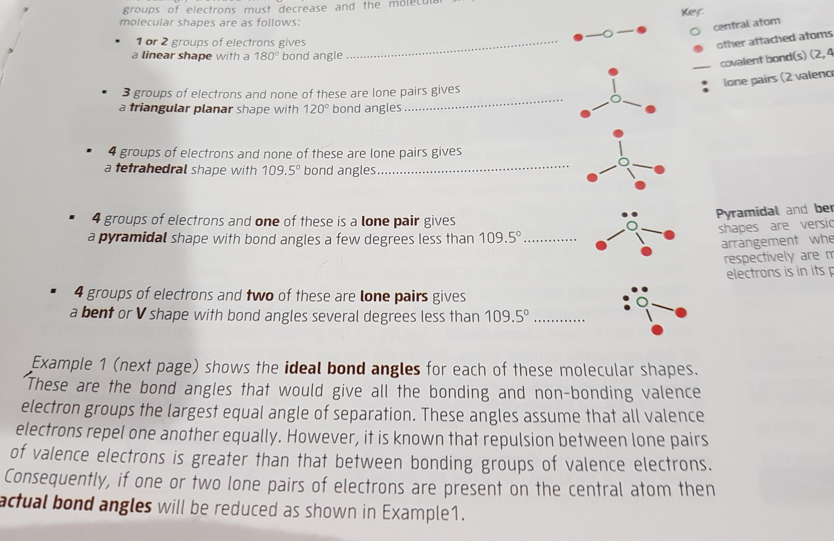
1 or 2 groups of electrons gives a linear shape with a 180⁰ bond angle
3 groups of electrons and none of these are lone pairs gives a triangular planar shape with 120⁰ bond angle

Slide 6
Water has unique physical & chemical properties. Its unique properties arise partly from the strength of the intermolecular forces between the water molecules. These forces are affected by the shape of the water molecules.

Slide 7
Forces between molecules
To break covalent bonds and isolate hydrogen and oxygen, you need to heat water to over 3000 degree celcius. Ice melts at 0 degree celcius and water vaporises at 100 degree celcius.
The relatively low temperatures are evidence that covalent bonds are not braeking. The low melting point shows that the intermolecular forces are much weaker than the covalent bonds within the molecule.

Slide 8
The intermolecular forces are much weaker than covalent bonds within molecules. The structure and composition of molecules determines which intermolecular forces are present. These forces determine the properties of the material.

Slide 9
Shapes of molecules
Molecules exist in a three-dimensional space, but we generally represent molecules in two dimensions. The structure and bonding in molecules is described by using either electron dot formulas or valence structures.
Shapes of molecules determine many physical properties of covalent molecular substances.
The shape of large molecules like DNA, scientists use complex techniques like X-ray crystallography or powerful computer simulations.

Slide 10
The shape of small molecules can be predicted using a relatively simple model known as the valence shell electron pair repulsion (VSEPR) theory.

Slide 11
Electron dot formulas
Atoms tend to be more stable when there are eight valence electrons around the central atom. This is known as octet rule.
Look at figure: C6.2, C6.3 in page: 259 NC
In covalent bonds, the electrons shared between two atoms are called the bonding pair of electrons.
A single bond is formed when one pair of electrons is shared. A double bond occurs when two pairs of electrons are shared between the two atoms.

Slide 12
The pairs of valence electrons not involved with bonding are called the lone pair or non-bonding pair of electrons.
Valence structures
Valence structures have the advantage of showing the structure of the molecules and are often called the structural formulas.
Electron dot formulas use pairs of dots to represent the bonding between atoms. Valence structures use lines to show the bonding, and non-bonding or lone pairs of electrons are shown as a pair of dots, crosses or a line and can be used to represent the shape of molecules.

Slide 13
Predicting the shape of molecules
The shape of molecules will determine the intermolecular bonding and properties of the substance.
The valence structure of water shows a two-dimensional shape in which oxygen is central to two hydrogen atoms. The three-dimensional shape could be the three atoms in a row, a V-shape molecule or two hydrogen atoms at right angles to the central oxygen.

Slide 14
Valence shell electron pair repulsion (VSEPR) theory has been used over 50 years to determine the shape and hence the function of many molecules. It gives an understanding of how proteins may bond to an enzyme, essential for many medical applications.
The “R” in VSEPR stands for the word “repulsion”, the theory is based upon the Pauli exclusion principle, not electron repulsion.

Slide 15
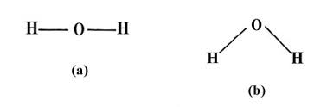


Pauli’s exclusion principle states that each orbital can have 0,1 or 2 electrons. If two electrons are present, then they spin in opposite directions around the nucleus. The discovery of this electron spin is fundamental to the Pauli exclusion principle.
Two electrons of the same spin have a zero probability of being found in the same location and will be found in locations as far apart as possible.

Slide 16
VSEPR theory is based upon the number of electron pairs surrounding the central atom. The electron pairs arrange themselves as if they repel each other.
The three-dimensional structure of simple molecules depends upon the number of electron pairs around the central atom. The electron dot formulas are used to indicate electron pairs.
These may be bonding and/ or lone pairs. The electron pairs will be at a maximum distance from each other. It helps to think of the electron pairs as points on a sphere with the central atom in the middle.

Slide 17
Lone pairs are closer to the single nucleus, so they occupy more space. Bonding pairs are shared by two atoms and are attracted by two nuclei. So, they occupy less space and cause less repulsion than lone pairs.
https://www.youtube.com/watch?v=nxebQZUVvTg

Slide 18
To work out the shape of a molecule:
Draw the electron dot formula
Count the lone pairs and bonding pairs.
Treat the electrons in a covalent bond, whether a single, double or triple bond, as one set of electrons.

